Slide 1
OPERATING SYSTEMS CSE 4300 Instructor: Mohammad Maifi Hasan Khan Chapter 6 Deadlocks

Slide 2
Preemptable and Nonpreemptable Resources
Sequence of events required to use a resource:
Request the resource.
Use the resource.
Release the resource.

Slide 3
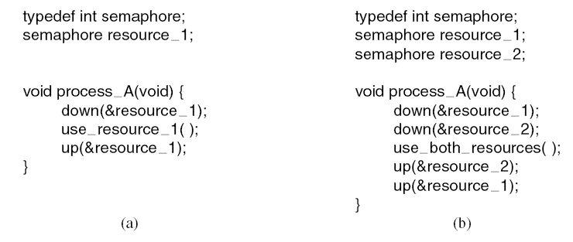
Resource Acquisition (1)
Using a semaphore to protect resources. (a) One resource. (b) Two resources.

Slide 4
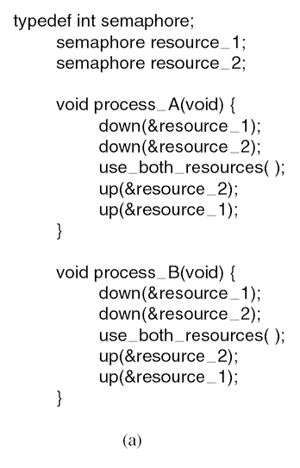
Resource Acquisition (2)
Deadlock-free code.

Slide 5
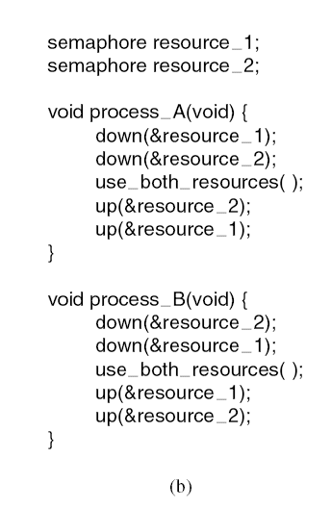
Resource Acquisition (3)
Code with a potential deadlock.

Slide 6
Introduction To Deadlocks
Deadlock can be defined formally as follows:
A set of processes is deadlocked if each process in the set is waiting for an event that only another process in the set can cause.

Slide 7
Conditions for Resource Deadlocks
Mutual exclusion condition: Each resource is either currently assigned to exactly one process or is available
Hold and wait condition: Processes can request new resources
No preemption condition: Process must explicitly release resources
Circular wait condition: Must be a circular chain of wait

Slide 8
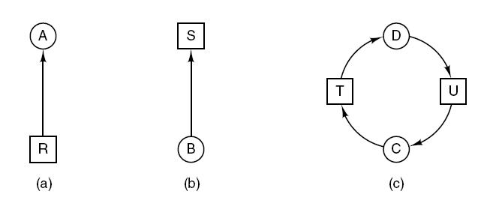
Deadlock Modeling (1)
Process: Circles
Resource: Squares
R is held by A
B is waiting for S
Resource allocation graphs. (a) Holding a resource. (b) Requesting a resource. (c) Deadlock.

Slide 9
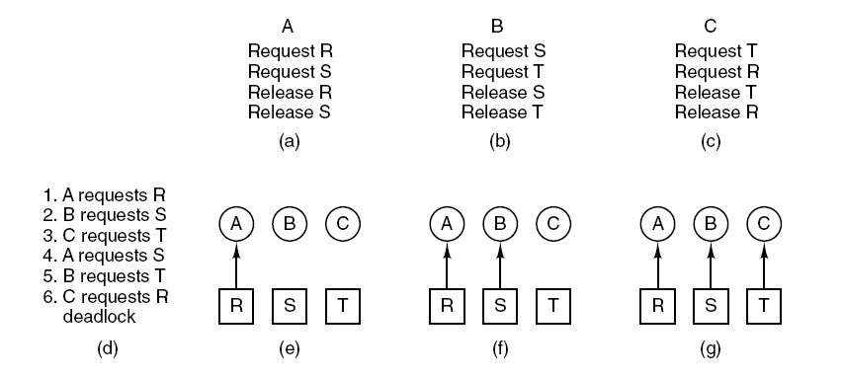
Deadlock Modeling (2)
An example of how deadlock occurs and how it can be avoided.

Slide 10
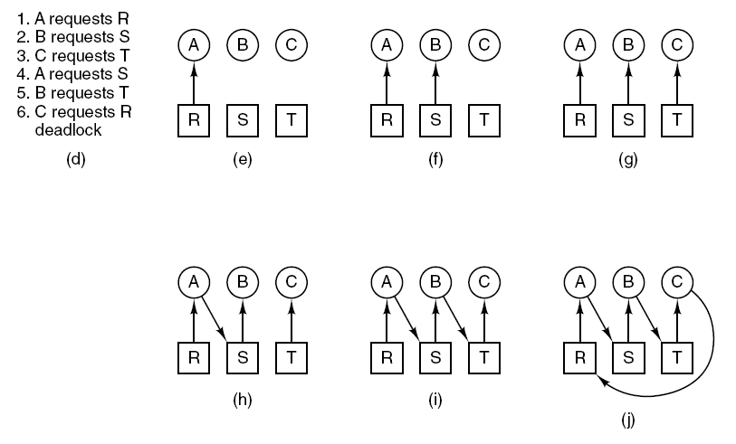
Deadlock Modeling (3)
An example of how deadlock occurs and how it can be avoided.

Slide 11
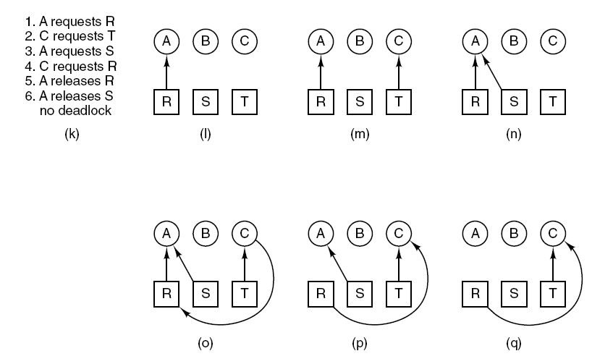
Deadlock Modeling (4)
An example of how deadlock occurs and how it can be avoided.

Slide 12
Deadlock Modeling (5)
Strategies for dealing with deadlocks:
Just ignore the problem.
Detection and recovery. Let deadlocks occur, detect them, take action.
Dynamic avoidance by careful resource allocation.
Prevention, by structurally negating one of the four required conditions.

Slide 13
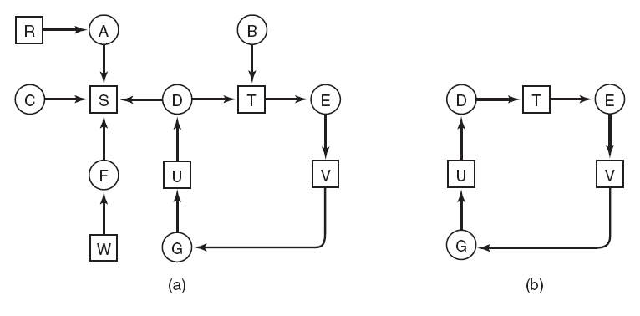
Deadlock Detection with One Resource of Each Type (1)
(a) A resource graph. (b) A cycle extracted from (a).

Slide 14
Deadlock Detection with One Resource of Each Type (2)
Algorithm for detecting deadlock:
For each node, N in the graph, perform the following five steps with N as the starting node.
Initialize L to the empty list, designate all arcs as unmarked.
Add current node to end of L, check to see if node now appears in L two times. If it does, graph contains a cycle (listed in L), algorithm terminates. …

Slide 15
Deadlock Detection with One Resource of Each Type (3)
From given node, see if any unmarked outgoing arcs. If so, go to step 5; if not, go to step 6.
Pick an unmarked outgoing arc at random and mark it. Then follow it to the new current node and go to step 3.
If this is initial node, graph does not contain any cycles, algorithm terminates. Otherwise, dead end. Remove it, go back to previous node, make that one current node, go to step 3.

Slide 16
Try the Algorithm on this one ☺
(a) A resource graph. (b) A cycle extracted from (a).

Slide 17
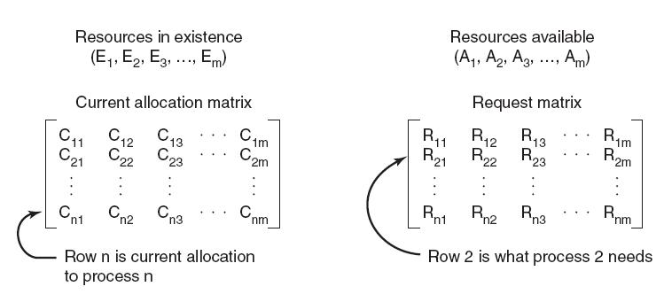
Deadlock Detection with Multiple Resources of Each Type (1)
The four data structures needed by the deadlock detection algorithm.

Slide 18
Deadlock Detection with Multiple Resources of Each Type (2)
Deadlock detection algorithm:
Look for an unmarked process, P_{i} , for which the i-th row of R is less than or equal to A.
If such a process is found, add the i-th row of C to A, mark the process, and go back to step 1.
If no such process exists, the algorithm terminates.

Slide 19
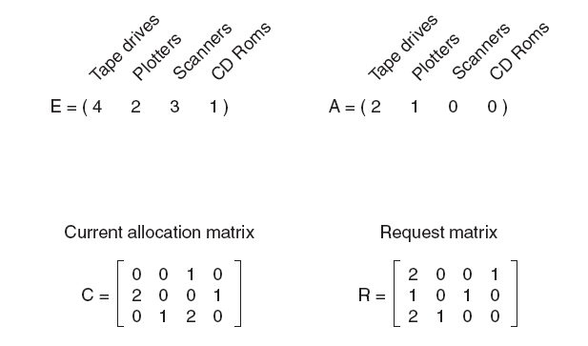
Deadlock Detection with Multiple Resources of Each Type (3)
An example for the deadlock detection algorithm.

Slide 20
Recovery from Deadlock
Recovery through preemption
Manually pause a print job and take away a printer
Recovery through rollback
Use “Checkpointing” to roll back a process to a time before it acquired the resource that can break the deadlock, pause, and restart later
Recovery through killing processes
Keep killing processes until the deadlock is broken.
You may kill a process which is not involved in the deadlock

Slide 21
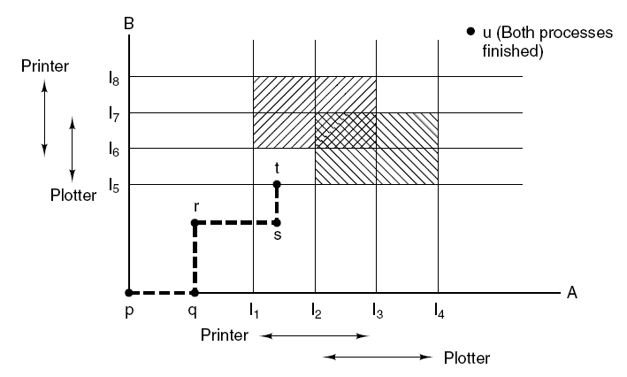
Deadlock Avoidance
Two process resource trajectories.

Slide 22
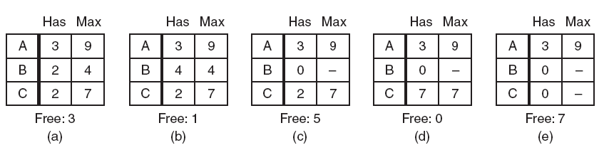
Safe and Unsafe States (1)
Demonstration that the state in (a) is safe.

Slide 23
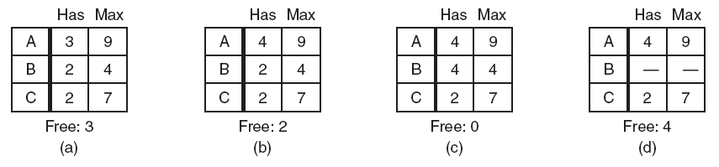
Safe and Unsafe States (2)
Demonstration that the state in (b) is not safe.

Slide 24
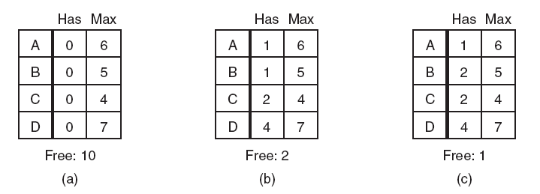
The Banker’s Algorithm for a Single Resource
Three resource allocation states: (a) Safe. (b) Safe. (c) Unsafe.

Slide 25
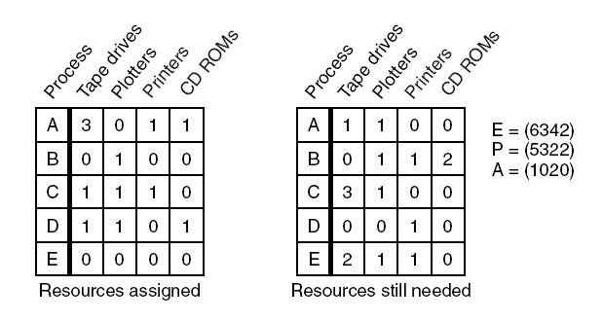
The Banker’s Algorithm for Multiple Resources (1)
The banker’s algorithm with multiple resources.

Slide 26
The Banker’s Algorithm for Multiple Resources (2)
Algorithm for checking to see if a state is safe:
Look for row, R, whose unmet resource needs all ≤ A. If no such row exists, system will eventually deadlock since no process can run to completion
Assume process of row chosen requests all resources it needs and finishes. Mark process as terminated, add all its resources to the A vector.
Repeat steps 1 and 2 until either all processes marked terminated (initial state was safe) or no process left whose resource needs can be met (there is a deadlock).

Slide 27
Deadlock Prevention
Attacking the mutual exclusion condition
No resources ever assigned exclusively to a single process
Not practical
Attacking the hold and wait condition
Request all resources at the beginning
Need to know a priori
Non-optimal use of resources
Attacking the no preemption condition
Virtualize resources (e.g., printer daemon)
Attacking the circular wait condition

Slide 28
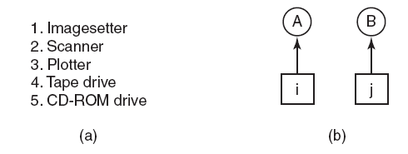
Attacking the Circular Wait Condition
(a) Numerically ordered resources. (b) A resource graph.

Slide 29
Other Issues
Two-phase locking
Database systems
Lock all the records before starts making changes. If all records not available, release and restart.
Not practical for real-time systems
Communication deadlocks
Request message gets lost
Timeout mechanism is used
Livelock (Not a deadlock)
All philosopher tries to acquire left fork, and then right fork
With small probability, they will keep trying
Starvation
What if a printer gives priority to small files?
Not a deadlock

